Slide 2
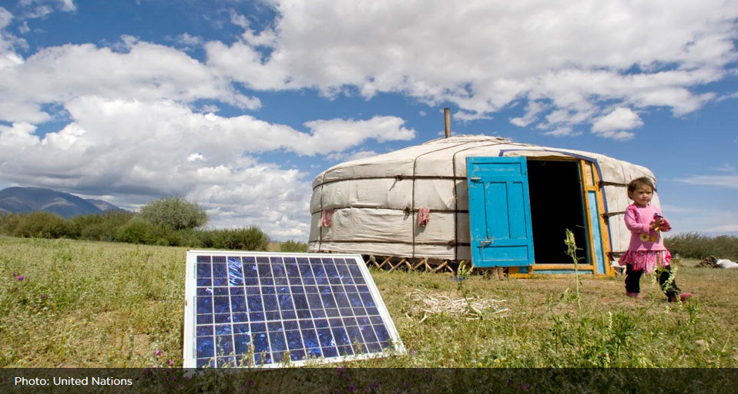
Transformations towards sustainability
“Understanding transformation processes and options, assessing how these relate to human values, emerging technologies and economic development pathways. Evaluating strategies for governing and managing the global environment across sectors and scales” (Future Earth)
Notes:
The Transformations towards Sustainability theme goes beyond assessing and implementing current responses to global change and meeting gaps in development needs. It will consider the more fundamental and innovative long-term transformations that are needed to move towards a sustainable future.
Future Earth will develop knowledge to understand, implement and evaluate these transformations. This might include significant shifts in political, economic and cultural values, changes in institutional structures and individual behaviours, large-scale systems changes and technological innovations that reduce the rate, scale and magnitude of global environmental change and its consequences.
Understanding the many feedbacks from human responses and governance to earth system processes requires close collaboration between natural and social scientists. Projecting the impacts of energy policy or ecosystem management on biogeochemical cycles and biodiversity is one area where interdisciplinary work is essential. Another is understanding how policy and international agreements shape demands for on-going monitoring of greenhouse gas emissions. Identifying the social and cultural consequences of different response strategies is an important focus.
Responding to global environmental change is not just a matter for national governments but also for local governments and international organizations, civil society, the private sector, and individuals. The Transformations towards Sustainability research theme requires partnerships that engage a wide range of stakeholders who are working on sustainable futures, including communities, businesses, humanitarian and conservation groups, and cultural leaders.

Slide 3
Transformations towards sustainability: Research Questions
Governance
Technologies
Values, beliefs, worldviews
Learning from past transformations
Long-term pathways to sustainable futures
Earth and social adaptation to change
Economic frameworks for global sustainability
Managing and utilising big data
Science-policy interaction
Notes:
Research under the Transformations Towards Sustainability theme will advance understanding of the following questions, and many related ones:
How can governance and decision-making be aligned across different levels, issues, and places to manage global environmental change and promote sustainable development? What is known about the successes and failures of different actors in managing global environmental change, at different scales, and using different strategies?
Can technologies provide viable solutions to global environmental change and promote sustainable development? What are the opportunities, risks and perceptions associated with emerging technologies such as geo-engineering or synthetic biology? How can technology and infrastructure choices be combined with changes in institutions and behaviours to achieve low carbon transitions, food security and safe water?
How do values, beliefs and worldviews influence individual and collective behaviour to more sustainable and mindful lifestyles, patterns of trade, production and consumption? What triggers and facilitates deliberate transformations at the individual, organizational, and systems levels; what socio-political and ecological risks does it entail?
What do we know about past transformations of the Earth System, as well as in ideas, technology and economy and how can the knowledge and lessons learned guide future choices?
What are the longer-term pathways towards sustainable urban futures and landscapes, successful and sustainable ‘blue’ societies, and a green economy?
What are the implications of global environmental change for conservation of species and landscapes including the possibilities for restoration, reversal of degradation and relocation?
How can the Earth and social system adapt to environmental changes that could include warming of more than 4°C over the next century?
Can our present economic systems, ideas and development practices provide the necessary framework to achieve global sustainability and if not, what can be done to transform economic systems, measures, goals and development policies for global sustainability?
What are the implications of efforts to govern and manage the Earth system for sustainability for scientific observations, monitoring, indicators and analysis? What science is needed to evaluate and assess policies and facilitate and legitimise transformation?
How can the massive volume of new geophysical, biological, and social data, including local knowledge and social media be managed and analysed so as to provide new insights into the causes, nature and consequences of global environmental change and to facilitate the identification and diffusion of solutions?

Slide 4
Transformations towards sustainability: “Co” concepts
“the research agenda and programmes should be co-designed and “where possible” co-produced by researchers in collaboration with “various stakeholders in governments, industry and business, international organisations, and civil society” (Future Earth)
Co-design, co-creation & co-production as ‘magic concepts’ (Pollitt & Hupe, 2011)
“…co-design is the process in which multiple stakeholders work together to design a scientific research process, whereas co-production can be seen as working together to actually carry out research, to generate and apply findings” (Melissa Leach, FE)
Different varieties and territories of co-production – Sheila Jasanoff:
Weak co-production – “… people sitting round a table to produce robust knowledge that is more useful, more robust, because people will buy into it, because they’ve already bought into the making of it”
Strong co-production – “… not just constructing a representation of the world as it is, but also concurrently a representation of the world as you want it to be in various ways.”
Challenges
Radical innovation
Enabling multiple voices to be heard
Considering future generations and non-human nature
Creating ‘collective efficacy’
“No definitive blueprint exists yet for this dimension of integration; it comprises new forms of learning and problem-solving action of different parts of society and academia that have not traditionally been in close contact” (Mauser et al, 2013)
Notes:
Magic concepts suggested to reform strategy for improved public policy
Spectrum of co-production (Sheila Jasanoff)
Co-production - ways in which science, knowledge, social order and society are produced together.
Politics of knowledge and a politics of ways of being (Melissa Leach, FE)
Co-production has arrived – at least in the UK – politicians speeches, whitehall strategy documents, think tank reports
Public service users are immense, hidden resource which can be used to transform srvices
Co-production sector in uk – nef, nesta
self=-build; time banks
Collective efficacy - “shared willingness of residents to intervene and social trust, a sense of engagement and ownership of public space”.
Sheila Jasanoff, ed. 2004. States of Knowledge: The Co-production of Science and Social Order. New York: Routledge.
‘coproduce’ policies that would be
more acceptable to both parties and, thus, be more effective at addressing social issues. The
notion of the coproduction of policies was viewed as something that echoed some of the
key principles of libertarian paternalism since there was an emphasis, as one civil servant
put it, on “working with the grain of human cognition”. Of course, it is possible to criticise
the coproduction of policy. Questions have been raised concerning the necessary link between
coproduction and the development of more effective policies (Needham, 2007). There is
also a broader danger that coproduction can lead to the development of populist policies
and a concomitant lack of leadership by government on various social issues. As one of our
respondents put it, it could be a case of “ ‘measuring peoples’ public opinion a lot and then
reacting to that.” (Whitehead)

Slide 5
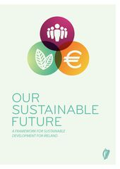
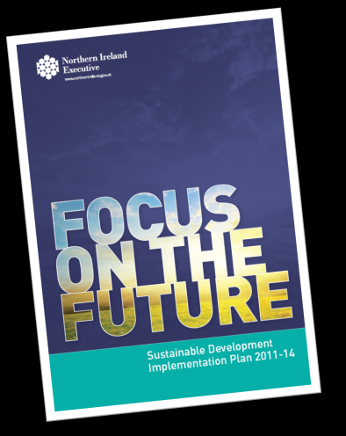
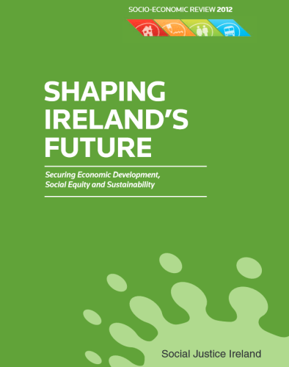
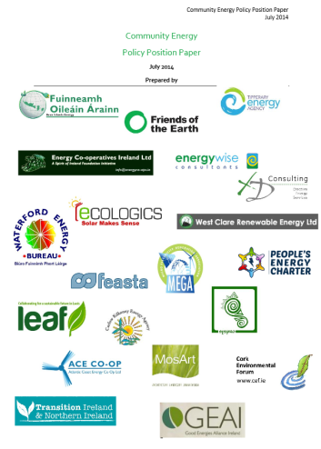
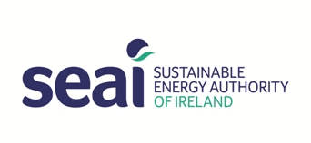
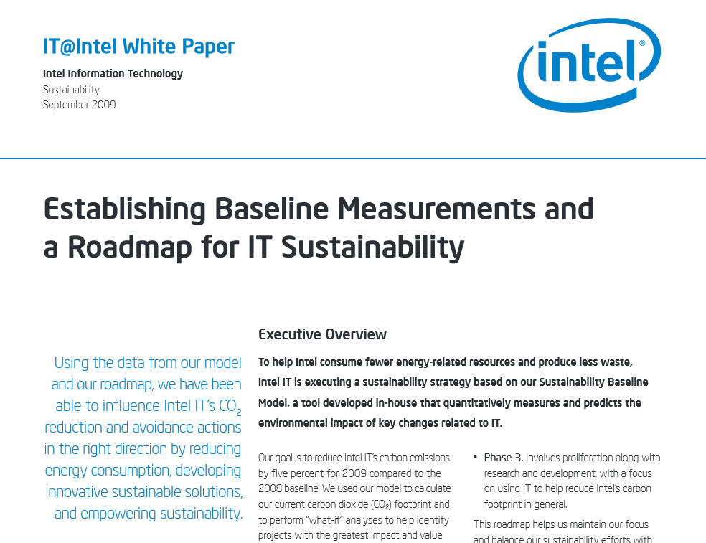
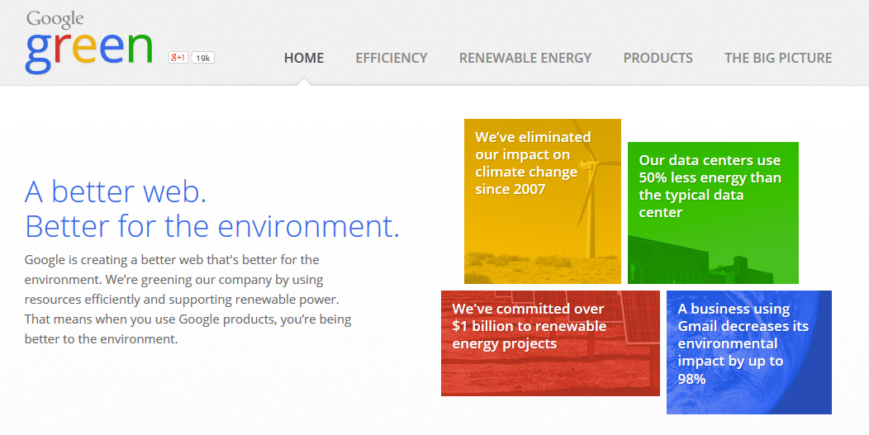
Transformations towards sustainability: Ireland
Notes:
Oceans Past Platform – http://www.cost.eu/domains_actions/isch/Actions/IS1403
MARNET – http://marnetproject.eu/
The programmable city – http://www.maynoothuniversity.ie/progcity/
City Watch - http://www.citywatch.ie/
I
RCE Dublin
The United Nations University (UNU) acknowledged the Regional Centre of Expertise in Education for Sustainable Development for the greater Dublin area (RCE Dublin on ESD) in March 2013. RCE Dublin is coordinated by DCU. The Director of RCE Dublin is Dr. Charlotte Holland. RCE Dublin has six projects that will be implemented in the greater Dublin area from 2014-2018:
Project 1 is ‘Green Teen Transitions’, which aims to enable youth transitions towards further education and/ or employment, through the use of a blended online model of learning and an internship programme.
Project 2 centres on a schools’ competition within the theme of ‘What-if: Disaster Mitigation’, making use of social media in a problem-based learning context.
Project 3 creatively examines urban sustainability through the lens of Irish literature, and uses ‘World Café’ style forums to ‘crowd-source’ solutions to sustainability issues.
Project 4 uses innovative means, such as foraging competitions, to help map indigenous horticultural practices that support bio-diversity, sustainable consumption and eco-management within the built environment.
Project 5 and Project 6 involve the design, delivery and evaluation of two blended online course within the themes of Ethical Sustainability and the Earth Charter for students within primary, post-primary and higher education.
These projects centre on the promotion of authentic and transformative learning experiences, with action projects that enable change agency towards sustainability within the RCE Dublin region.
SCH COST Action IS1403 Oceans Past Platform (OPP)
Descriptions are provided by the Actions directly via e-COST.
The Action, Oceans Past Platform (OPP), aims to measure and understand the significance and value to European societies of living marine resource extraction and production to help shape the future of coasts and oceans. The Integrative Platform will lower the barriers between human, social and natural sciences; multiply the learning capacity of research environments; and enable knowledge transfer and co-production among researchers and other societal actors, specifically by integrating historical findings of scale and intensity of resource use into management and policy frameworks.
The oceans offer rich resources for feeding a hungry world. However, the sea is an alien space in a sense that the land is not. Fishing requires skills that must be learnt, it presupposes culinary preferences, technical ability, knowledge of target species, and a backdrop of material and intangible culture. OPP asks when, how and with what socio-economic, political, cultural and ecological implications humans have impacted marine life, primarily in European seas in the last two millennia.
The Action calls on historians, archaeologists and social scientists as well as colleagues from the marine sciences to engage in dialogue and collaboration with ocean and coastal managers. OPP will develop historical descriptors and indicators for marine and coastal management.
MARNET (Marine Atlantic Regions Network) is a 2.5 year collaborative transnational project involving maritime regions from the Basque country of Spain, Brittany in France, Stirling in Scotland, Porto in Portugal as well as the Border Midland and West region of Ireland. NUI Galway is the lead scientific partner of the MARNET project which is mapping the value of the Atlantic marine economy through the development of socio-economic indicators. The members of the NUI Galway MARNET research team are Dr Frances Fahy, Dr Stephen Hynes, Dr Amaya Vega and Rebecca Corless. The large-scale project involves the participation of academics working with Regional Authorities across the Atlantic Area. Local Authorities with marine interests will benefit from the MARNET project through the development of practical initiatives aimed at growing the marine sector at a local level.

Slide 6
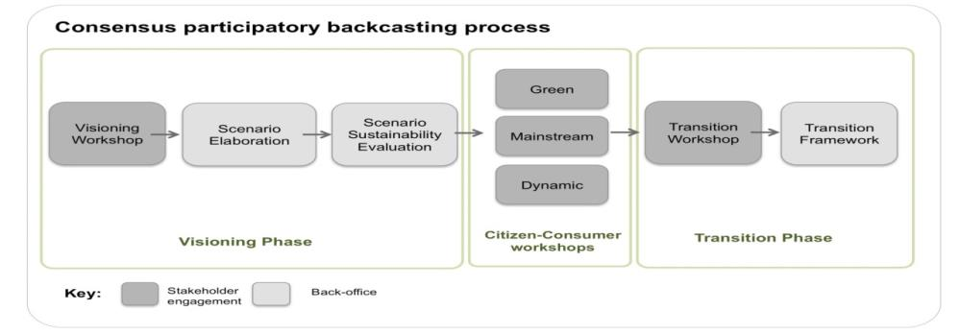
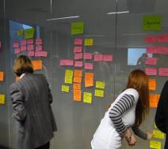
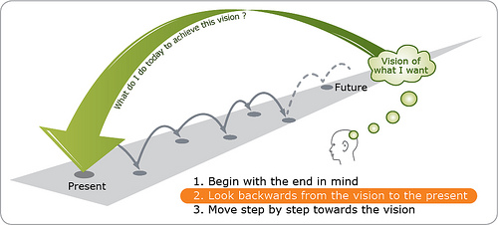
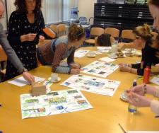
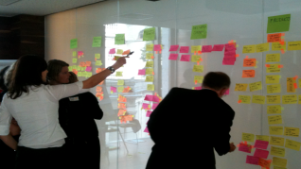
participatory backcasting
co-designing scenarios for smart and sustainable living in 2050
CONSENSUS POP Backcasting Approach
Notes:
“…first creating a desirable (sustainable) future vision or normative scenario, followed by looking back at how this desirable future could be achieved, before defining and planning follow-up activities and developing strategies leading towards that desirable future” (Quist & Vegragt, 2006, 1028).
PHASE 1 2009-2013
CO-CREATING VISIONS & TRANSITION PLANS
80+ commercial, NGO and policy stakeholders were involved in visioning workshops to develop future scenarios for sustainable eating (focusing on food shopping, cooking and wasting practices in particular).
Future scenarios contained complimentary bundles of concepts for new:
Products
Technologies
Regulations
Educational / lifestyle initiatives.
After extensive public feedback & sustainability evaluation, the most promising food scenario concepts were identified. Long-term Transition Plans were created to build towards their achievement.
SusHouse fulfilment of home shelter, food and clothing functions in the year 2050.
Lovins – backwards looking analysis – long term energy policy in the united states
It’s focus on creating a desirable future vision – normative – sets it apart from other foresight trends – forecasting based on extrapolating from current trends
SCENES project:
The SCENES is a 4-year project developing and analysing a set of comprehensive scenarios of Europe's freshwater futures up to 2025, covering all of "Greater" Europe reaching to the Caucasus and Ural Mountains, and including the Mediterranean rim countries of north Africa and the near East. These scenarios will provide a reference point for long-term strategic planning of European water resource development, alert policymakers and stakeholders about emerging problems, and allow river basin managers to test regional and local water plans against uncertainties and surprises which are inherently embedded in a longer term strategic planning process.
Studies – all with different whys and hows
Backcasting –practical technique, used especially for policy making in NL and also for strategic planning in business.
Jump to a point in the future – imagine a more desirable alternative
Then look back to develop plans on how you might get there. (possible vs likely) V’s forecasting where you extrapolate from current trends- unlikely to deliver trend breaking solutions
I’ll explain in more detail the processes
Involves a range of interdisciplinary stakeholders – concerned with Process (mainly learning & interaction promo E4S) & Products (ideas that arise – visions, Transition Plans). New insights into the nature of problems & new directions for solutions
While BC = more recent & practical visioning technique – parallels to be made with other traditions - merges elements of utopian thinking & critical design.

Slide 7
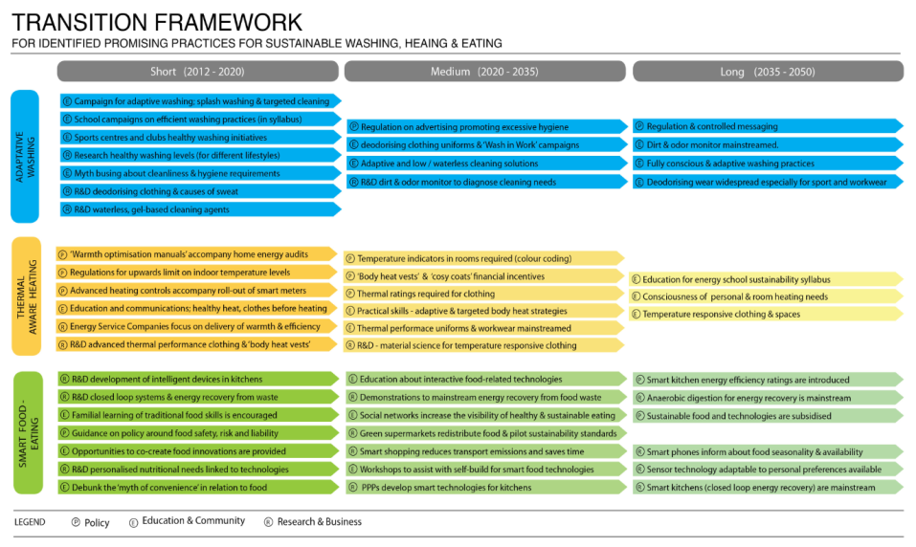
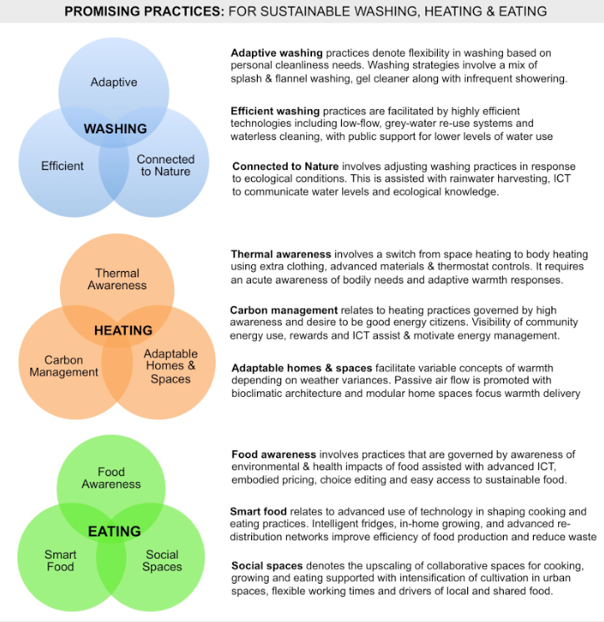

Slide 8
Prototyping & evaluating promising practices
“Collaborator” relations with stakeholders:
Commercial enterprises: from MNE to start-up entrepreneurs from USA and Canada to Ireland
Utilities and government agencies
NGO initiatives and social enterprises
Householders
10 households: 5 for washing and 5 for eating
5 week intensive ethnographic study with new devices, products, regulatory conditions & educational tools for sustainable eating and washing.
Notes:
POP backcasting experiments created unique and valued moments for engagement, collaborative learning, nexus thinking and transdisciplinary interaction – bridging mechanism but isolated experiment
HomeLabs are necessary testbeds for exploring how promising practices for more sustainable consumption might be enacted, resisted, modified

Slide 9
Transformations towards sustainability
Transformation requires:
Technological advances
New concepts of welfare
Diverse social innovations
Unprecedented level of international cooperation
Opportunities:
Maturing of technologies, increased awareness, changing values towards sustainability, reduction in cost and increased investment
Challenges:
Political, institutional, economic path dependencies, vested interests, cost
The transformation to a sustainable society is a process of ‘trial and error’ – of searching and learning – for society and requires far more democracy. Only a democracy can facilitate the debates that are the essential prerequisite for legitimate policy decisions. (WBGU, 2011)
Many thanks for your attention
Prof. Anna Davies
Trinity College Dublin
Email: daviesa@tcd.ie
Notes:
trust, in other words. But because this was Harvard, they needed a more impressively complicated word to describe it, and Sampson called it ‘collective efficacy’.
He described it as a “shared willingness of residents to intervene and social trust, a sense of engagement and ownership of public space”.
new encounters, including commercialisation, open innovation, participatory social science, engaged arts, and public engagement. These new encounters are disrupting conceptions of where knowledge resides, how problems are framed, and who should be mobilised to influence research. ‘Co-production’ is the term increasingly used to describe these new encounters, and is shaping research council agendas, institutional practices, and academic identities.
CONSENSUS Project: reflecting on co-production within co-production?
Who gets to participate?
How can different contributors meet on equal terms?
How best to learn how to bring them together?
Where to next?
of debates is required as solutions to unsustainable consumption are still predominantly generated by elites and focused on either information deficit models, or technological fixes and design-led solutions;
Reorienting discussions from end of pipe environmental problems (e.g. water scarcity or energy emissions) to the practices that consume resources (washing, heating) allows attention to be placed on how the needs those practices fulfil (refreshment, relaxation, comfort) might be otherwise (and more sustainably) met;
Shiftshaping is complex, ongoing, but uncoordinated and infused with spatial and scalar politics of transitioning;
POP backcasting experiments created unique and valued moments for civic engagement, collaborative learning and transdisciplinary interaction amongst participants, where attention to the shaping of everyday practices can be collectively imagined and critically debated;
HomeLabs: provide bounded implementation testbeds for exploring more sustainable scenarios for sustainable consumption
TM & SP - common recognition of the need to move beyond product innovation, eco-efficiency or redesign strategies, to consider integrated socio-cultural, technological and organisational changes to achieve transitions towards sustainable ways of life
POP backcasting Such spaces are a pre-cursor to any meaningful attempt to co-ordinate interventions towards reducing unsustainable consumption.
Unsustainable consumption is the mother of all current environmental problems (EEA, 2012)
UNEP 2012) – measuring progress
Energy consumption in the EU is likely to increase by 9 % between 2005 and 2020 (EC, SCP)
Consumption of products and services impacts the environment in many different ways. For example, the things we buy contribute, directly or indirectly through the product lifecycle, to climate change, pollution, biodiversity loss and resource depletion in Europe and other regions.
“stuff” (taking the case of personal washing, stuff would include showers and taps); “skills” (practical know-how on how and when to wash); “understandings” (social expectations of cleanliness) (Warde 2005; Shove et al. 2008) and, adopting a macro focus, broader “rules” (that often relate to systems of provision and regulation) (Spaargaren 2003). Under this conceptualisation, stability in practices arises when stuff, skills, understandings and rules are integrated and reproduced, while practices are transformed as the links between elements are broken or new elements added (Pantzar and Shove 2010). Conceptualised in this way, any deliberate attempts to transform specific practices requires co-ordinated and complementary actions across these social and material elements by a range of actors and citizens. Yet, this presents challenges for contemporary governing approaches where isolated interventions prevail, particularly in the context of sustainable consumption where informational approaches dominate (Davies et al. 2010). It also raises highly contentious spectres of social engineering for sustainability (Shove and Walker 2008).

